Slide 1
Opportunities with Mustard

Slide 2
Topics
Hybrid Brown 18 Mustard
Yellow 80 Mustard
Benefits of each
Agronomic information
Mustard under irrigation
Mustard 21 and their role

Slide 3
Hybrid Brown 18
Hybrid Brown 18 was launched in 2019 First hybrid mustard in the world Developed by Dr Bifang Cheng with AAFC Going to a hybrid was similar when it was done with canola Growers are seeing the hybrid advantage with mustard Quicker plant development and more plant matter which results in higher yields

Slide 4

AAC Brown 18: Agronomics
yield index maturity height lodging
bu/ac days cm
Centennial
Brown 31.3 100 88 134 none
AAC
Brown 18 38.8 124 89 138 none
N=17
Source: 2016-2017 CFIA Registration Document

Slide 5
AAC Brown 18: Disease Rx
White Rust Blackleg Clubroot Verticillium
2a 2v
Centennial susc. res highly susceptible susceptible
Brown resistant
AAC susc. res highly susceptible susceptible
Brown 18 resistant
N=2
Source: 2016-2017 CFIA Registration Document

Slide 6
Seeding rate and fertility
Hybrid Brown 18
Seeding rate is 4.5lbs to 6.0lbs per acre
Fertility recommendation is 80lbs to 100lbs of N

Slide 7
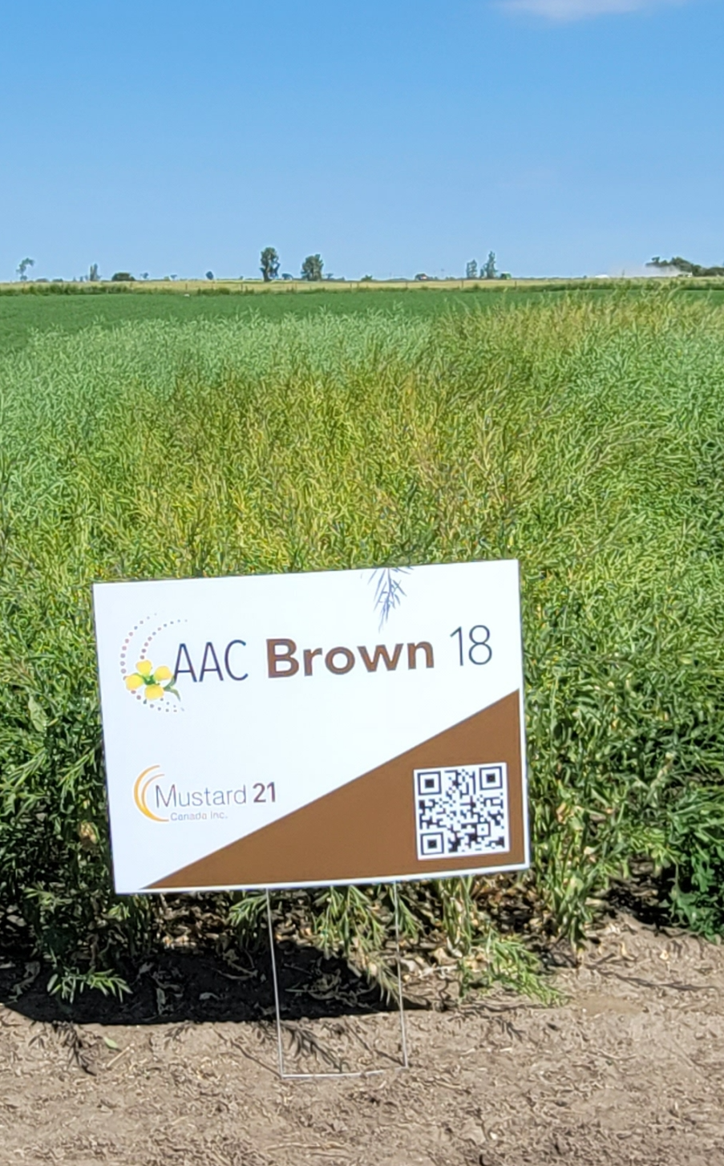
AAC Brown 18
This variety has proven to be a top performer in spite of the last three years of drought we had
Hybrid Brown 18 is showing yield advantage over Centennial Brown of 18% to 20%
This year a significant number of brown mustard acres will be Hybrid Brown 18

Slide 8
ICDC Irrigation 2022
Seeding date: May 21, 2022
Harvest date: August 17 (Hybrid) and August 24 (Yellow)
Fertilizer and Soil test
  Soil test (0 to 24): N – 60 lb/ac and P – 3ppm
  Fall banding of P – 53 lb/ac (60kg/ha)
  Spring – N 98 lb/ac (banded) and P 18 lb/ac (seed placed)
  UAN – At the start of flowering, sprayed with 30 lb N and 20 lb P/ac to lessen vegetative growth and produce more flowers

Slide 9
ICDC Irrigation 2022
Crop Protection – Matador twice for flea beetles
Irrigation/precipitation – 6.5 inches of irrigation and 4 inches of rain.

Slide 10
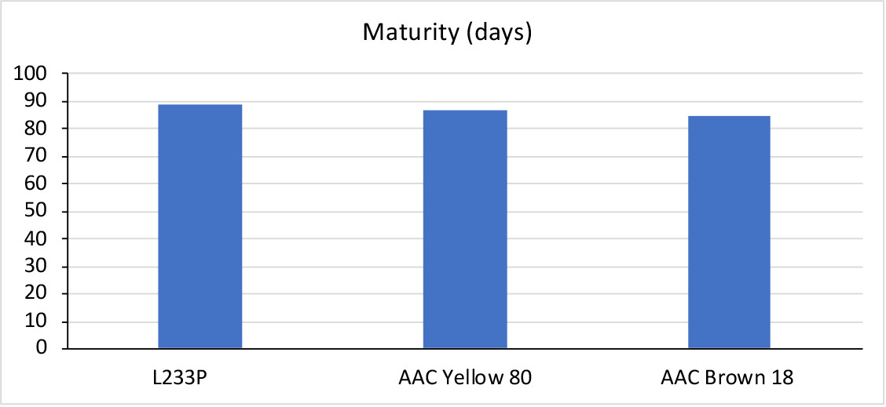
ICDC Irrigation 2022 Maturity Results
88.75
86.5
85

Slide 11
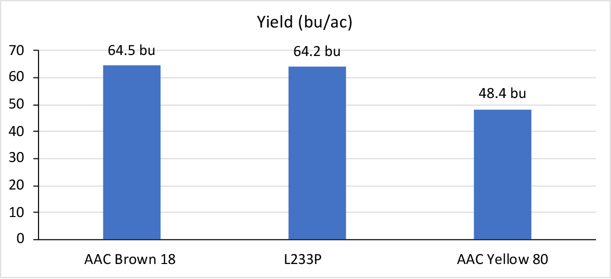
ICDC Irrigation 2022 Yield Results

Slide 12
AIM Site 2022 – Time Lapsed Photos
At the Ag In Motion site in 2022 M21 had planted Hybrid Brown 18 as well as AAC Yellow 80.
The site is light soil but there was adequate moisture at seeding.
As time moved on the site dried out and required some irrigation.
Once the plants emerged I took time lapsed photos to see how the crop advanced.

Slide 13
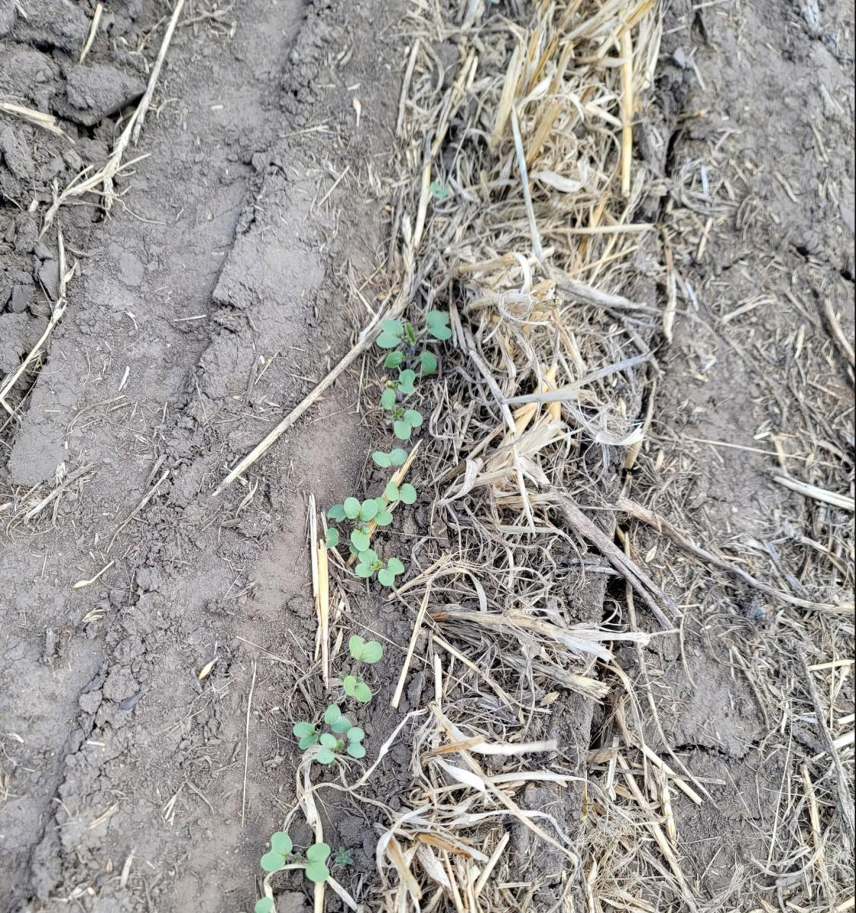
June 1, 2022

Slide 14
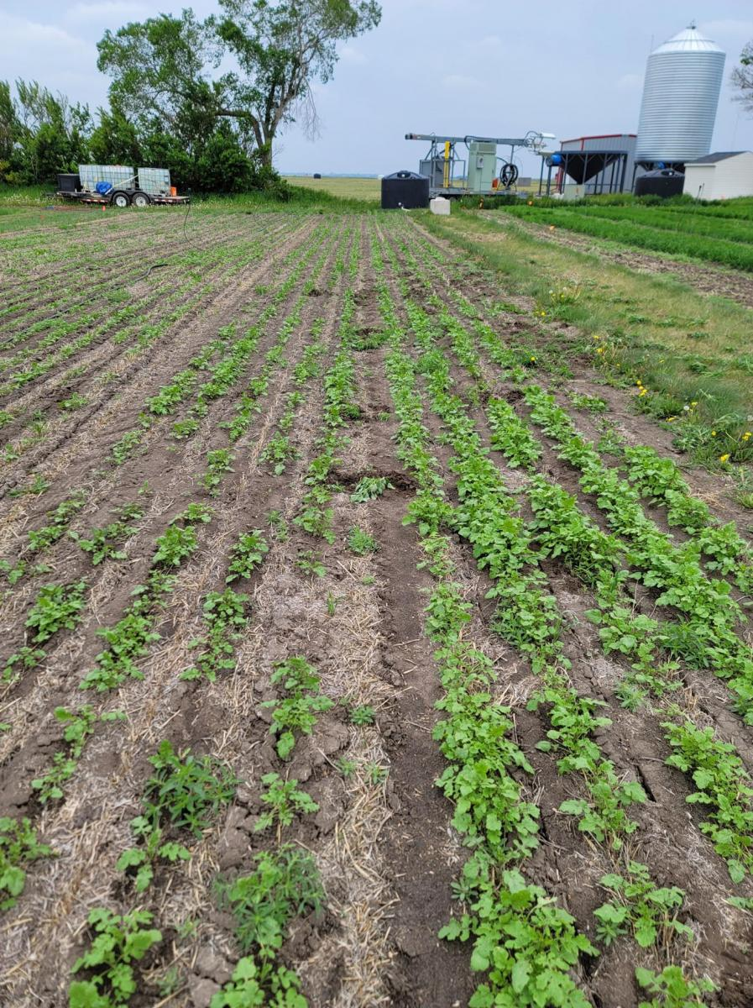
June 13 2022

Slide 15
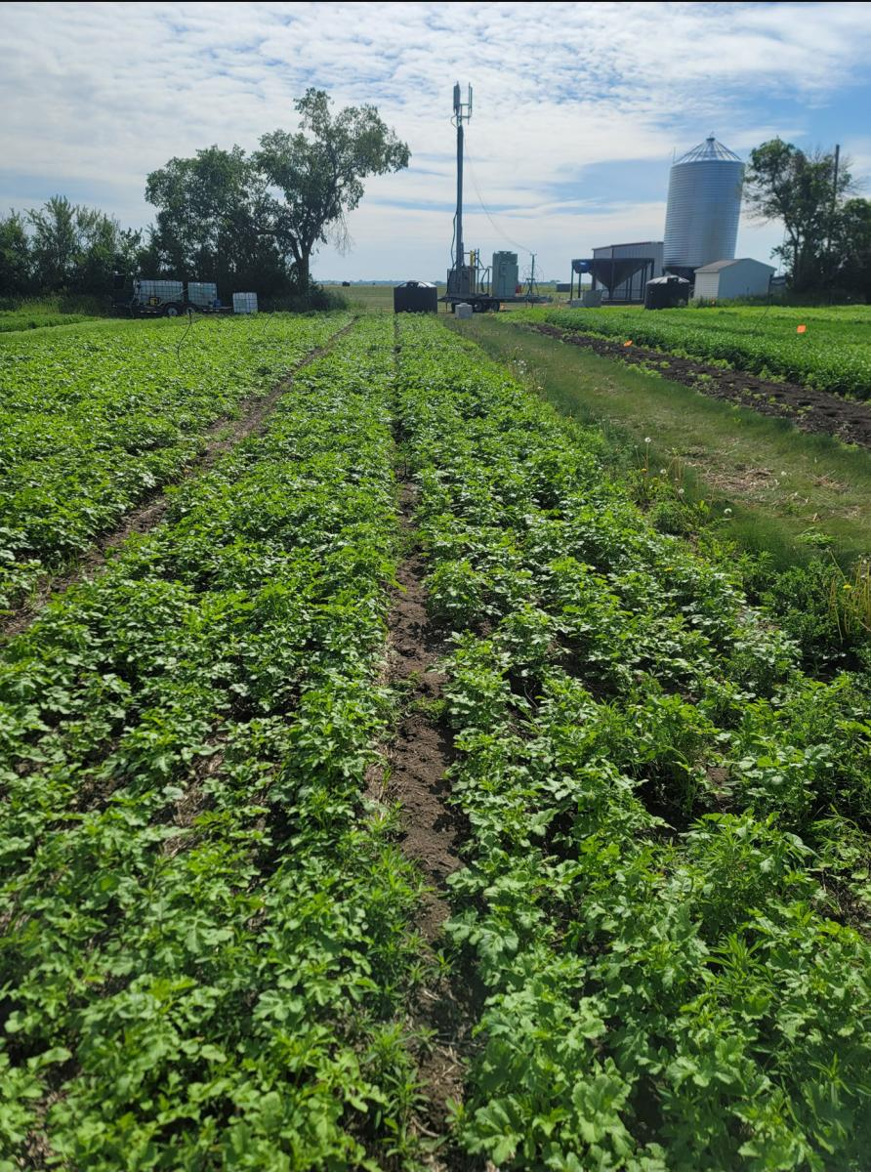
June 22 2023
javascript:;

Slide 16
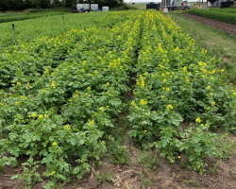
June 29 2022

Slide 17
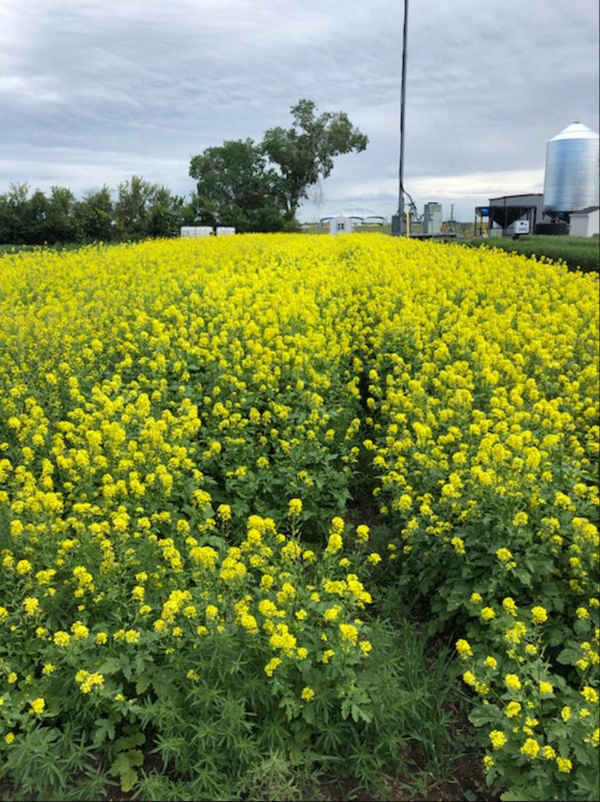
July 10 2022

Slide 18
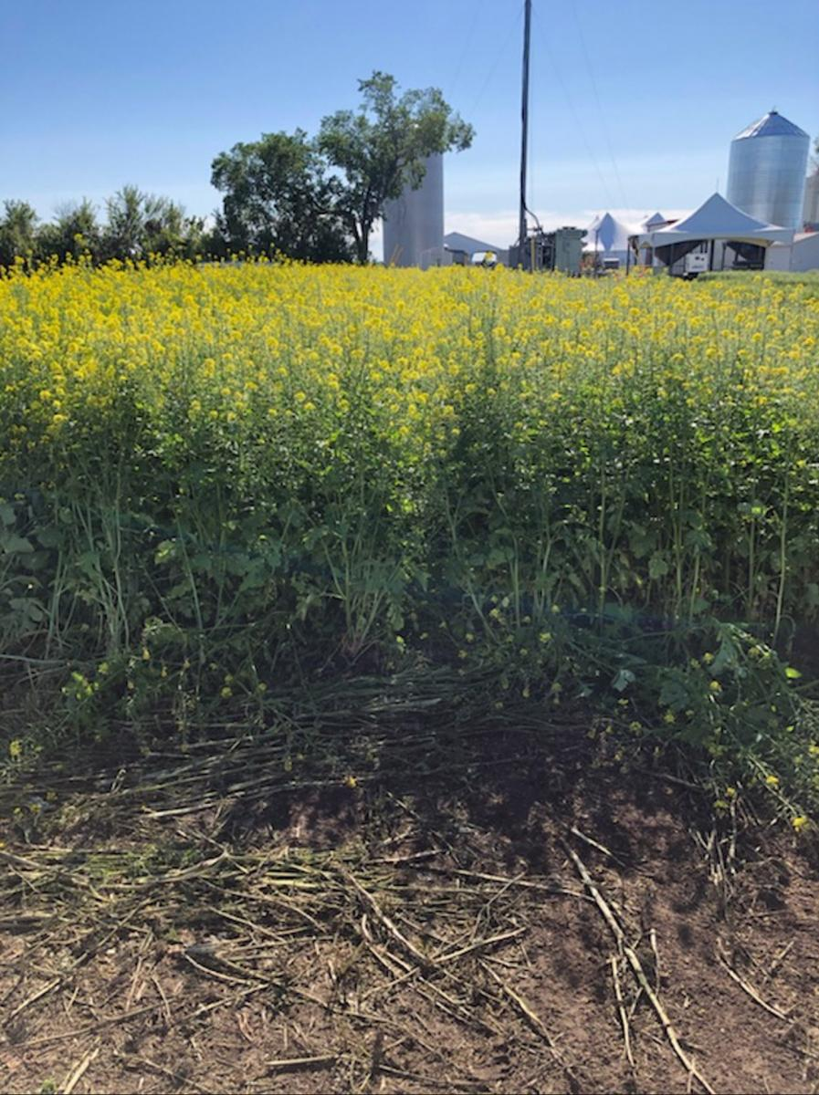
July 14 2022 during AIM show

Slide 19
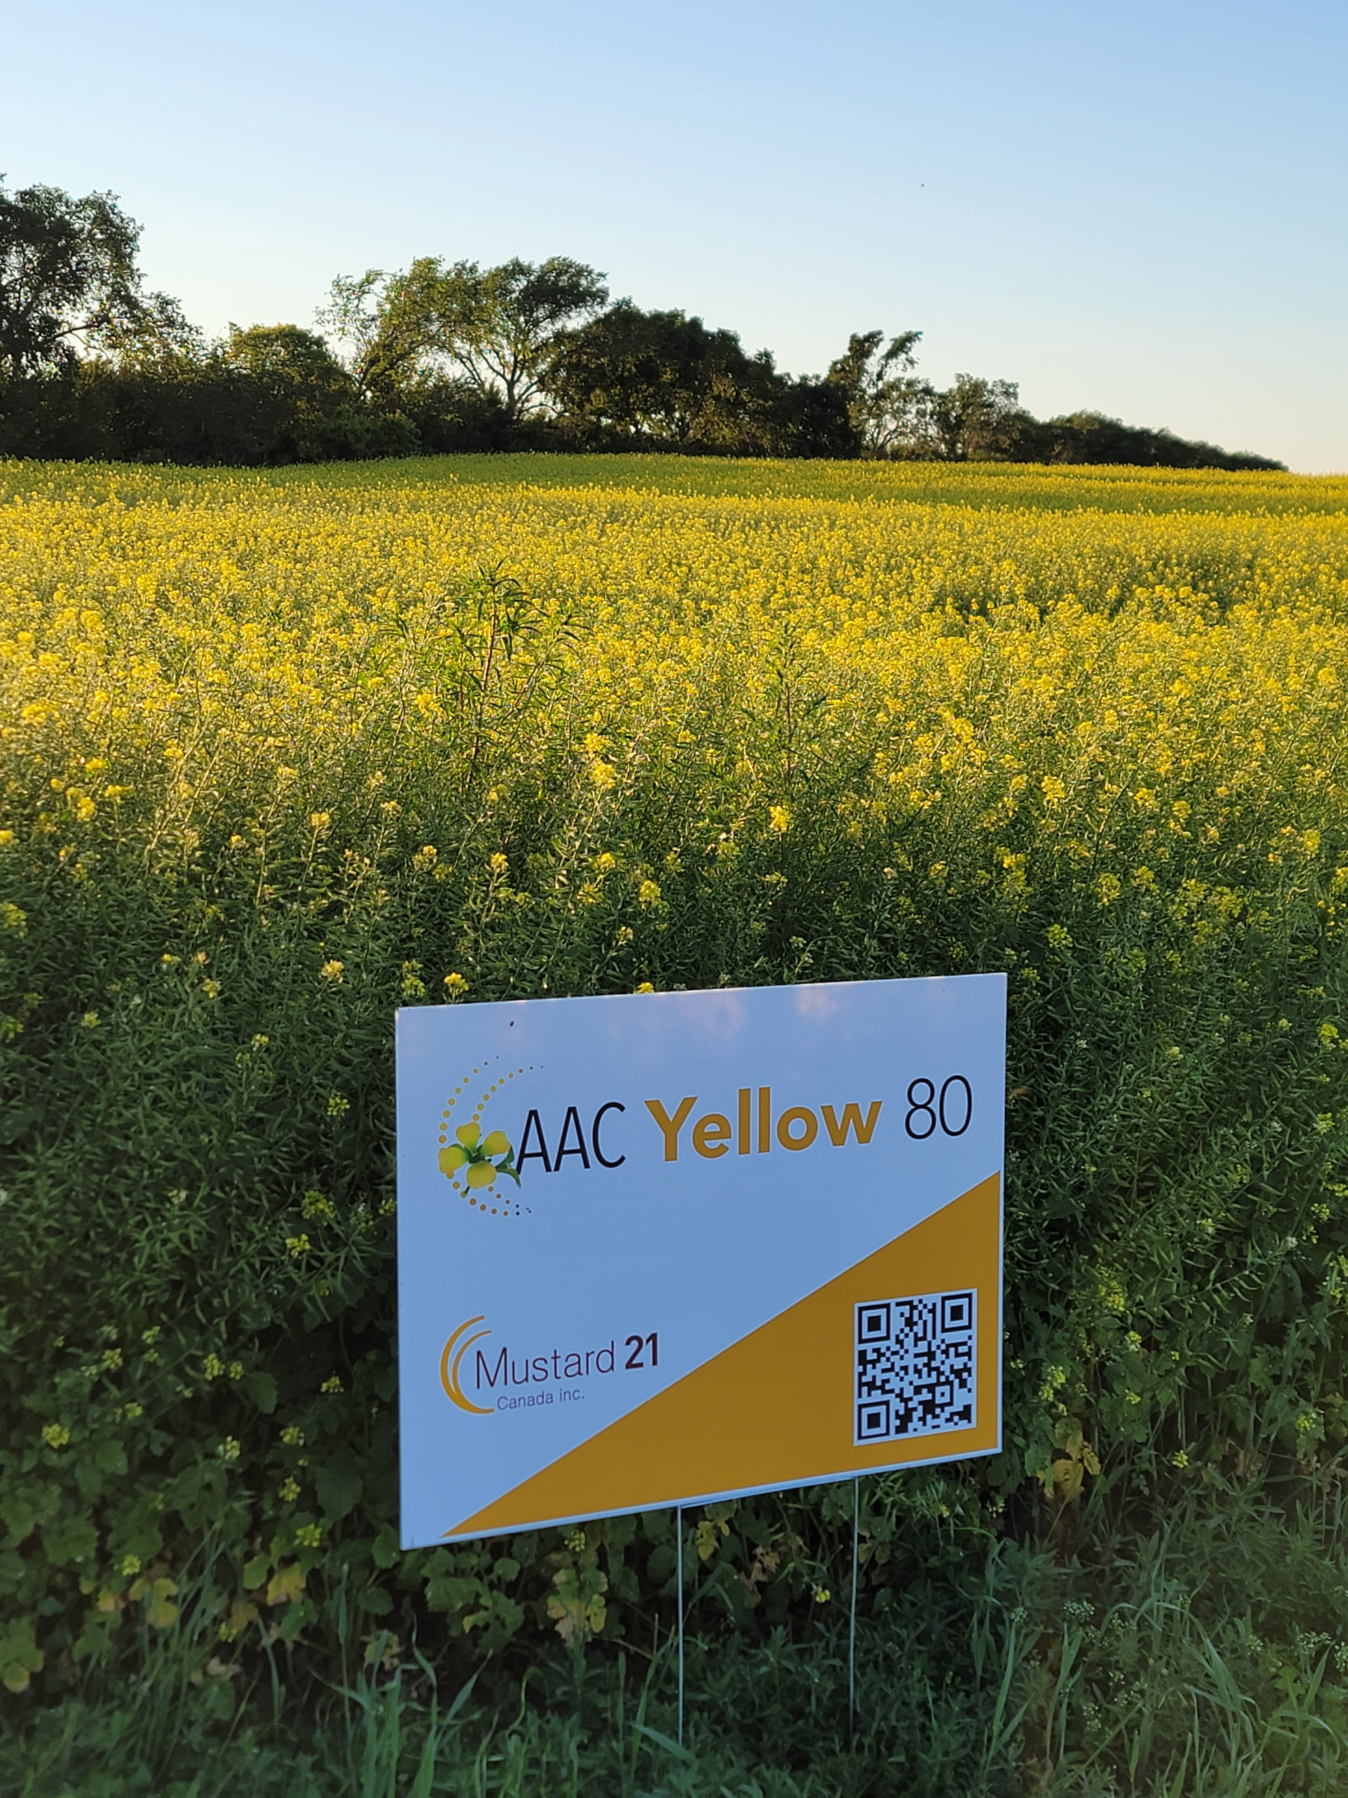
AAC Yellow 80
AAC Yellow 80 is a composite variety
It yields 10% higher than the OP variety Andante
This year I had several calls from growers saying how good it looks in the field and the same was said about the research plots

Slide 20
AAC Yellow 80: Agronomics
yield index maturity height lodging
bu/ac days cm
Andante 26.2 100 80 110 none
AAC
Yellow 80 29.9 113 79 110 none
N=13
Source: 2022 MAT trials

Slide 21
AAC Yellow 80: Disease Rx
White Rust Blackleg Clubroot Verticillium
2a2v 7a7v
Andante res. res. resistant susceptible susceptible
AAC res. res. resistant susceptible susceptible
Yellow 80
N=2
Source: 2020 CFIA Registration Document

Slide 22
Seeding rate and fertility
AAC Yellow 80
Seeding rate is 10lbs per acre, working on determining the optimum rate.
Fertility recommendation is 80lbs to 100lbs of N

Slide 23
Mustard 21 Update
Background
The vision for M21 was to drive the research projects and handle the duties of working with Ag Canada on these projects. Designed to span the entire value chain in our approach to government and in designing the goals of the work.
M21 board of director's consists of seven members. Three board members are from CMA, three from SMDC and one is from the industry.

Slide 24
Mustard 21
In the last 2 years the role of M21 has changed and seed sales have become an important part of the duties of M21
This involves sales, marketing, developing varieties and plant breeding work with Ag Canada.

Slide 25
Research Projects
The past 5 years had Mustard 21 and Sask Mustard have been involved in the Canadian Agricultural Partnership program.
The big wins that came out of that for mustard growers was Hybrid Brown 18 and Yellow 80.
Advancement was also made on clubroot resistance in mustard, herbicide tolerance and disease resistance.
Testing for new hybrids has also began to continue to build on the yield advantage.

Slide 26
Research Activities
Mustard 21 is working hard to get non-GMO herbicide tolerance and club root resistance into mustard.
In addition Mustard 21 is working with Ag Canada plant breeder Dr. Bifang Cheng to get higher yielding hybrid’s in mustard as well.
Mustard 21 has been working with Nuseed to develop a Carinata line of mustard that will fit into the bio fuel market as well.

Slide 27
What’s Next
Advancement in clubroot resistance in mustard
Herbicide tolerance
Greater disease resistance.
Testing for new hybrids has also began to continue to build on the yield advantage.
Hybrid Oriental mustard

Slide 28
Acknowledgments
M21 thanks the following organizations for their support:
Agriculture and Agri-Food Canada (AAFC)
Diverse Field Crop Cluster
Agriculture Development Fund
Results Driven Agriculture Research (RDAR)
Our Industry Partners:
Western Grains Research Foundations (WGRF)
Saskatchewan Mustard Development Commission (SMDC)
Canadian Mustard Association (CMA)

Slide 29
Thank you – Questions?

